Slide 1
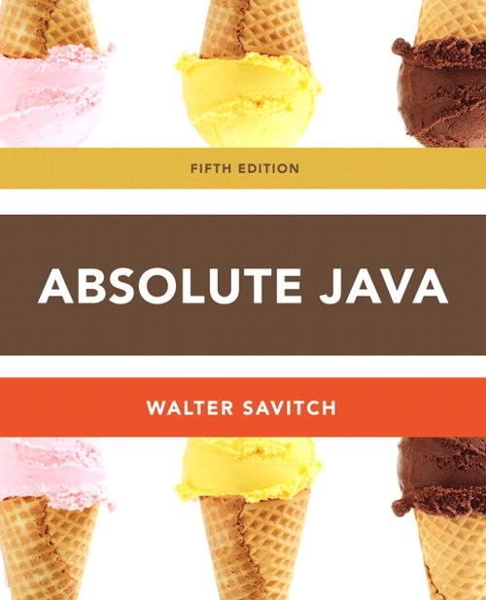
Chapter 2
Screen Output Section 2.1
Slides prepared by Rose Williams, Binghamton University
Kenrick Mock, University of Alaska Anchorage

Slide 2
System.out.println for console output
System.out is an object that is part of the Java language
println is a method invoked by the System.out object that can be used for console output
The data to be output is given as an argument in parentheses
A plus sign is used to connect more than one item
Every invocation of println ends a line of output
System.out.println("The answer is " + 42);

Slide 3
println Versus print
Another method that can be invoked by the System.out object is print
The print method is like println, except that it does not end a line
With println, the next output goes on a new line
With print, the next output goes on the same line

Slide 4
Formatting Output with printf
Starting with version 5.0, Java includes a method named printf that can be used to produce output in a specific format
The Java method printf is similar to the print method
Like print, printf does not advance the output to the next line
System.out.printf can have any number of arguments
The first argument is always a format string that contains one or more format specifiers for the remaining arguments
All the arguments except the first are values to be output to the screen

Slide 5
printf Format Specifier
The code
double price = 19.8;
System.out.print("$");
System.out.printf("%6.2f", price);
System.out.println(" each");
will output the line
$ 19.80 each
The format string "%6.2f" indicates the following:
End any text to be output and start the format specifier (%)
Display up to 6 right-justified characters, pad fewer than six characters on the left with blank spaces (i.e., field width is 6)
Display exactly 2 digits (rounded) after the decimal point (.2)
Display a floating point number, and end the format specifier (i.e., the conversion character is f)

Slide 6
Right and Left Justification in printf
The code
double value = 12.123;
System.out.printf("Start%8.2fEnd", value);
System.out.println();
System.out.printf("Start%-8.2fEnd", value);
System.out.println();
will output the following
Start 12.12End
Start12.12 End
The format string "Start%8.2fEnd" produces output that is right justified with three blank spaces before the 12.12
The format string "Start%-8.2fEnd" produces output that is left justified with three blank spaces after the 12.12

Slide 7
Multiple arguments with printf
The following code contains a printf statement having three arguments
The code
double price = 19.8;
String name = "magic apple";
System.out.printf("$%6.2f for each %s.",
price, name);
System.out.println();
System.out.println("Wow");
will output
$ 19.80 for each magic apple.
Wow
Note that the first argument is a format string containing two format specifiers (%6.2f and %s)
These format specifiers match up with the two arguments that follow (price and name)

Slide 8
Line Breaks with printf
Line breaks can be included in a format string using %n
The code
double price = 19.8;
String name = "magic apple";
System.outprintf("$%6.2f for each %s.%n", price, name);
System.out.println("Wow");
will output
$ 19.80 for each magic apple.
Wow

Slide 9
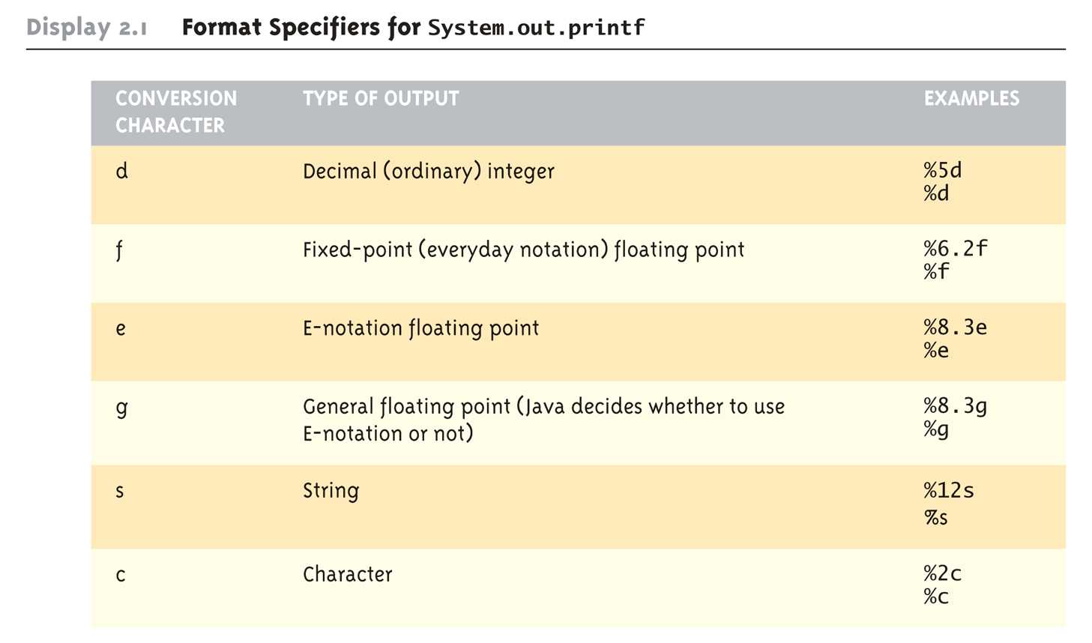
Format Specifiers for System.out.printf

Slide 10
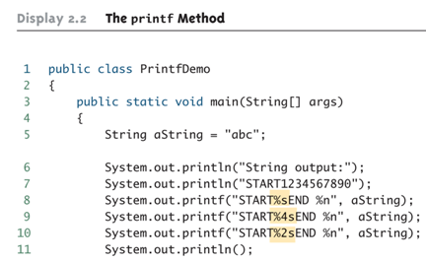
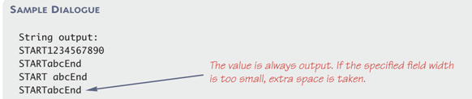
The printf Method (Part 1 of 3)

Slide 11
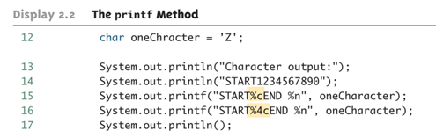

The printf Method (Part 2 of 3)

Slide 12
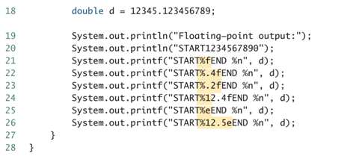
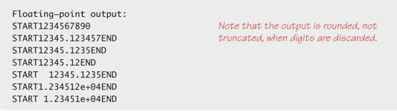
The printf Method (Part 3 of 3)
Note: The default for decimals is 6 decimal places

Slide 13
Formatting Money Amounts with printf
A good format specifier for outputting an amount of money stored as a double type is %.2f
It says to include exactly two digits after the decimal point and to use the smallest field width that the value will fit into:
double price = 19.99;
System.out.printf("The price is $%.2f each.“
price);
produces the output:
The price is $19.99 each.

Slide 14
Legacy Code
Code that is "old fashioned" but too expensive to replace is called legacy code
Sometimes legacy code is translated into a more modern language
The Java method printf is just like a C language function of the same name
This was done intentionally to make it easier to translate C code into Java

Slide 15
Money Formats
Using the NumberFormat class enables a program to output amounts of money using the appropriate format
The NumberFormat class must first be imported in order to use it
import java.text.NumberFormat
An object of NumberFormat must then be created using the getCurrencyInstance() method
The format method takes a floating-point number as an argument and returns a String value representation of the number in the local currency

Slide 16
Money Formats
import java.text.NumberFormat;
public class CurrencyFormatDemo {
public static void main(String[] args) {
System.out.println("Default location:");
NumberFormat moneyFormater =
NumberFormat.getCurrencyInstance();
System.out.println(moneyFormater.format(19.8));
System.out.println(moneyFormater.format(19.81111));
System.out.println(moneyFormater.format(19.89999));
System.out.println(moneyFormater.format(19));
System.out.println();
}
}

Slide 17
Money Formats
Output of the previous program
Default location:
$19.80
$19.81
$19.90
$19.00

Slide 18
Specifying Locale
Invoking the getCurrencyInstance() method without any arguments produces an object that will format numbers according to the default location
In contrast, the location can be explicitly specified by providing a location from the Locale class as an argument to the getCurrencyInstance() method
When doing so, the Locale class must first be imported
import java.util.Locale;

Slide 19
Specifiying Locale
import java.text.NumberFormat;
import java.util.Locale;
public class CurrencyFormatDemo {
public static void main(String[] args) {
System.out.println(“France as location:");
NumberFormat moneyFormater2 =
NumberFormat.getCurrencyInstance(Locale.FRANCE);
System.out.println(moneyFormater2.format(19.8));
System.out.println(moneyFormater2.format(19.81111));
System.out.println(moneyFormater2.format(19.89999));
System.out.println(moneyFormater2.format(19));
}
}

Slide 20
Specifying Locale
Output of the previous program
France as location:
19,80 €
19,81 €
19,90 €
19,00 €

Slide 21
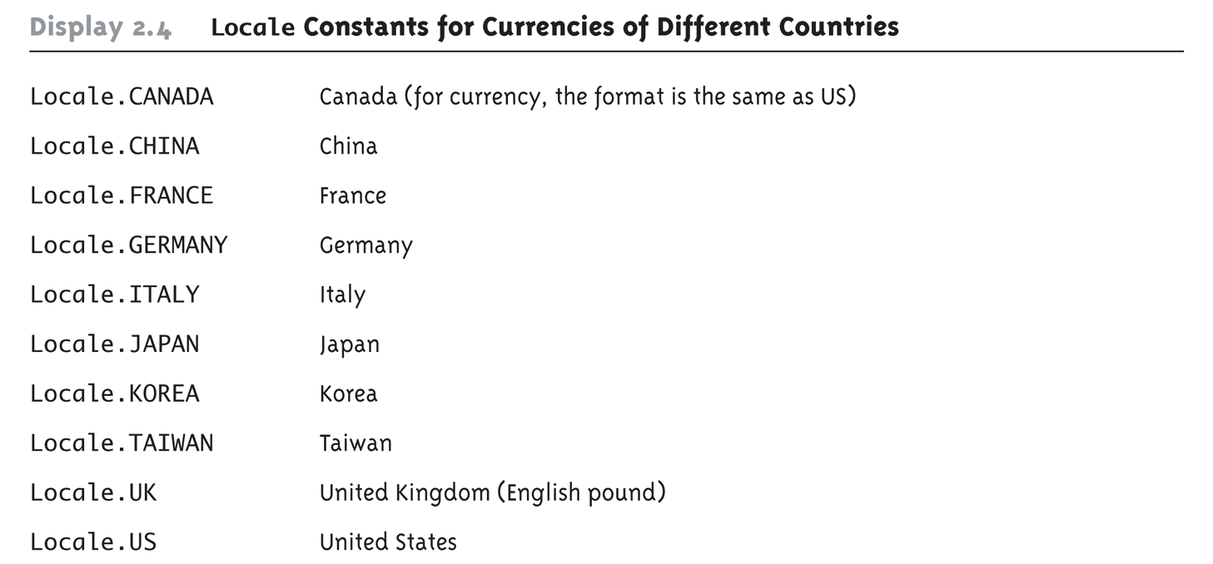
Locale Constants for Currencies of Different Countries

Slide 22
Importing Packages and Classes
Libraries in Java are called packages
A package is a collection of classes that is stored in a manner that makes it easily accessible to any program
In order to use a class that belongs to a package, the class must be brought into a program using an import statement
Classes found in the package java.lang are imported automatically into every Java program
import java.text.NumberFormat;
// import theNumberFormat class only
import java.text.*;
//import all the classes in package java.text

Slide 23
The DecimalFormat Class
Using the DecimalFormat class enables a program to format numbers in a variety of ways
The DecimalFormat class must first be imported
A DecimalFormat object is associated with a pattern when it is created using the new command
The object can then be used with the method format to create strings that satisfy the format
An object of the class DecimalFormat has a number of different methods that can be used to produce numeral strings in various formats

Slide 24
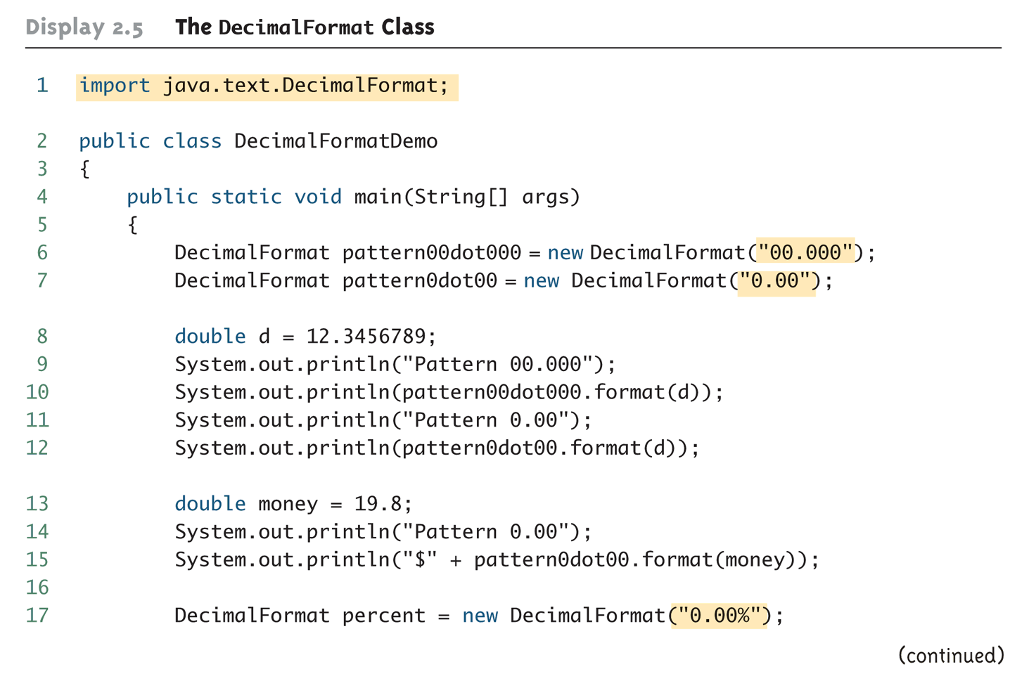
The DecimalFormat Class (Part 1 of 3)

Slide 25
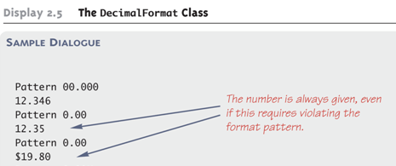
The DecimalFormat Class (Part 2 of 3)

Slide 26


The DecimalFormat Class (Part 3 of 3)

